Slide 1
Azure FinOps
Peter Perov

Slide 2
Azure FinOps
An Introduction

Slide 3
Agenda
Customer Scenarios
General FinOps Framework
Azure Specific Optimizations

Slide 4
Introduction

Slide 5
Why FinOps
?

Slide 6
Heavy Logging
$15k per month, +12 new PostgreSQL, turns on logging for audit purposes
Consumption grows +$4k (25%)
Mitigation:
logging is not auditing
use Change Data Capture for audit
reduce cost for logging ingest
Notes:
With happy ending
By about 25%

Slide 7
Next Gen
Organisation spends $70k per month
CTO is tasked with building next gen cloud app
Cloud spending goes up to $300k per month
CTO is fired
New CTO is hired and asks for our help
Notes:
I debated with my colleagues decision to fire the CTO but we couldn’t come a conclusion.
On one hand a person who made a mistake is more experienced than the person who didn’t
On the other hand controlling Cloud Spending is a responsibility of CTO, and he failed at that
I’ll leave it up to you to decide
But IMO controlling Cloud Spending is becoming CTO’s direct responsibility

Slide 8
Traditional purchasing process
Developer needs a thing, she creates a request
Request is approved by a management chain
Finance pays the bill
Developer gets a thing

Slide 9
Public Cloud
On-Demand
Scalable
Self-service
Measurable
Spending decisions are made by engineers
Notes:
Public cloud is great!
And a measurable per second spending report.
So the purchasing process on the cloud
Developer has keys to the cloud
Developer creates cloud resource
Resources incur charges
Cost gets out of control

Slide 10
Purchasing on the cloud
Developer has keys to the cloud
Developer creates cloud resource
Resources incur charges
Cost gets out of control
Notes:
So the
Developer has keys to the cloud
Developer creates cloud resource
Resources incur charges
Cost gets out of control

Slide 11
Risks
Technical Complexity
Micro-billing can be hard to understand
Different Languages (technical, organisational, business)
Lack of information
Human factor
Other priorities
Notes:
I can see the following risks in this scenario
Technical complexity – Azure itself has 500+ services all with at least 3 tiers of pricing
Micro billing can be a burden.
Human factor:
Overprovisioning
Wrong Licensing (Developer/Standard/Enterprise)
Other Priorities
(pushback)
Bad Actors
Crypto mining

Slide 12
Mitigation – Enter FinOps
FinOps – framework for managing, planning and accounting.
Combination of Processes and Technology
Financial accountability to the variable spend model of the cloud.
Make business trade offs between speed, cost and quality.
Notes:
It is necessary for an organisation to allocate, explain and control cloud spending.
FinOps terminology evolved over time:
Cloud cost management
Cloud cost optimization
Cloud financial management

Slide 13
What’s needed for FinOps?
Leadership support and influence
Stakeholder alignment
Communicate/Evangelise FinOps culture
Notes:
And general communication about FinOps culture across the organisation

Slide 14
FinOps Value
Accountability of usage pushed to the edge
Product teams manage their own usage against the budget
Decentralise resource usage and optimization decisions
Technical teams must consider cost as an efficiency metric
Just in time visibility of cloud cost to all levels
Fast feedback loops lead to behaviour change
Centralised FinOps reduces duplicated effort
Discount negotiation with cloud vendor is centralised
Continuous adjustments in cloud usage optimisation
Notes:
This slide explains the benefits of FinOps to the Technology Leadership
But I think it’s beneficial for our team as it lays out benefits of introducing FinOps in the organisation
* Decentralise resource usage and optimization decisions
To avoid situation where Finance buys a lot of cloud and no one uses it.

Slide 15
FinOps =
Real Time Reporting + Just-in-time processes + Teams working together
Notes:
FinOps cosists of three major pillars

Slide 16
FinOps role
Cross functional position
Mixture of Technical & Accounting skills
Authority, diligence, communication, evangelism, responsibility
Understanding Cloud Fundamentals and Cloud Pricing strategies
Raising cost awareness across organisation
Regular meetings with dept. managers/architects
Daily – go through daily usage and justifications
Weekly/Monthly – go through period usage and discuss spikes
Owns centralised cloud cost control model
Notes:
Part technical, part manager, part accounting

Slide 17
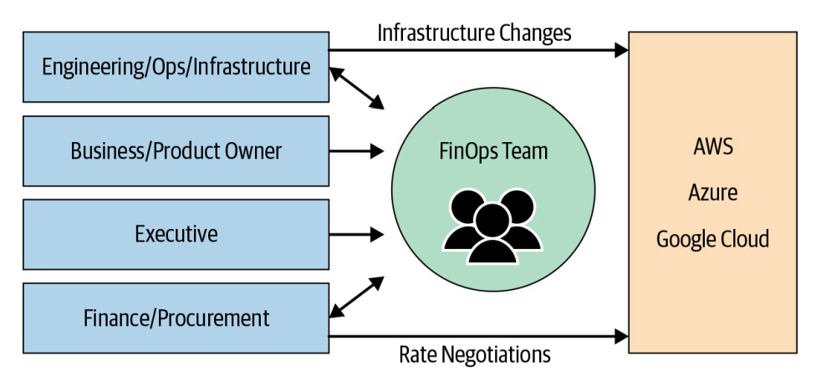
FinOps Role
Notes:
In the organisation topology
Somewhat centralised cost control model.
Having observed many FinOps teams I think that the best position for FinOps is under Chief Operating Officer (COO).
Engineers
Want to work on something meaningful and fun
Want to deliver software fast and reliably
Hate inefficiency and want efficient use of resources
Stay up to speed on the latest tech
Are measured by uptime
Want to deliver features, fix bugs, and improve performance
Would prefer not to worry about cost (but are responsible for incurring it)
Finance People
Want to accurately forecast and predict spending
Want to be able to charge back and/or allocate 100% of spending
Seek to amortize costs appropriately to the teams responsible
Want to split out shared costs, like support and shared services
Want to control and reduce costs, but maintain quality/speed
Want to help executives inform cloud strategy
Want to be aware of budget risks
Executives
Want to drive shared accountability to teams
Desire a digital business transformation
Want to shorten time to market for new services
Seek a competitive advantage
Want to establish a successful cloud strategy
Need to define and manage KPIs (key performance indicators)
Must prove the value of tech investments

Slide 18
Indirect Influence
Cant’ influence resource usage directly
But!
Can sit down with the team and understand the quality
Suggest optimization strategy
Understand the business value
Communicate the value to business stakeholders
Help make business decision what to do next (change the service pricing, make it a new product for the market)
Notes:
DBA refused to discuss low usage DB service ($100 monthly)
Pick a phone and call the person
Understand the reasoning and service importance
Communicate the importance
Show historical usage (only 100 per month, but 2400 over last 2 years)

Slide 19
FinOps analysis
Analyse Cloud Spending
Analyse Resource Utilisation
Rightsizing
Suggest service alternatives
Notes:
Real time reporting is a powerful influence on human behaviour.
Rightsizing - resizing cloud resources to better match workload requirements

Slide 20
Resource Inventory
Communicate the importance of tagging
Collective responsibility rather than individual (whole group/department)
Cost related tag for each department
Enforce tag existence with Azure Policy on creation
Scan all resources and tag them
Identify resource owner/creator
Who created what?
When was it created?
Does the owner still work in the organisation?
Report resource utilization
Notes:
Report Utilization
Usage metrics for each resource:
Number of connections
Compute utilisation (CPU, Memory)
Storage Utilization
To catch cases such as 2 weeks no one connected to the database. Why?

Slide 21
Culture Practise
Introduce the importance from the beginning (onboarding)
Regularly promote FinOps (why? And how?)
Continuously promote sustainability
Encourage resource conservation
Encourage engineers to consider resource cost
Notes:
We can consider FinOps as a Culture practise aimed at encouraging good behaviour.
Some examples of encouragement:
Department that saved on the cloud may receive additional funding for contractors or other vouchers.
Organization can provide vouchers to the teams who optimized their spending during the period.
Encourage good behaviour
Becomes another decision making parameter: Cost + Speed + Reliability

Slide 22
Human processes
Separation of responsibilities
Request approval process
Governance and Licensing
Continuous Review
Resource Utilization
Resource Necessity
Encourage good behaviour
Notes:
Engineer, engineering manager, departmental manager.
FinOps regularly meets with one of the engineering managers to discuss cloud spending over the period.

Slide 23
Why Separate Role?
Many resources created by multiple teams lead to disagreements who’s accountable for shared resources usage
Central person/team – can define and own metrics for everyone

Slide 24
Technology Processes

Slide 25
Azure specific tech processes
Preventive
Azure Blueprints
Azure Policies
Continuous
LMAA
Analysis + Review
Autoscale

Slide 26
LMAA
Collect information
Logging
Analyse
Monitoring
Notify
Alert
Mitigate
Action

Slide 27
LMAA Technologies
Logging
Azure Monitor
Alert
Alert Rule
Action
Alert Rule + Action
Blueprints + Policies
Monitoring
Log Analytics
Application Insights
Budget Alert
Cost Alert

Slide 28
Cost Alert
Budget Alerts
Credit Alerts
Department spending quota

Slide 29
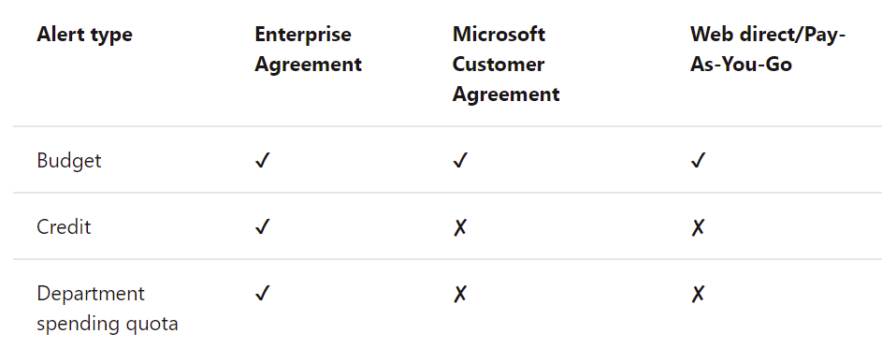
Alert availability per subscription type
Notes:
https://docs.microsoft.com/en-us/azure/cost-management-billing/costs/cost-mgt-alerts-monitor-usage-spending

Slide 30
Approach
Various tools to help with FinOps

Slide 31
3 pillars
Visibility
Accountability
Optimisation
Notes:
But some customers would like more customization, so of course there are views, but they would like to have more customizations. Maybe they'd like to integrate this with their back end systems, so we have the power BI connector, which it's more customizable, but it's not out of the box. Customer needs to build their own reports, but it's there for customers. Would like to do this and I've seen lots of customer build very impressive types of reports using this power BI connector.
If it's not enough, there are the cost API which which is the the most extensible way to look at cost to give you an example how you would use this, I've helped the customer that wanted to report the cost of the idle application gateways and their environment. They want to have a good business case to say that those are not used. We need to delete them. So we had a query to get all of the idle application gateways and then we use the API.
To get the the last month cost of those gateways so that they can have a good case to their management to say those are not used, they're costing this this this much per month. We need to delete them. So API is.
Is the most extensible. So as we move from left to right, we increase in complexity and also increase in in flexibility.
So I'm not gonna talk a lot about this. I'm sure all of you have played with this before, but one thing I'm gonna add here is.
The the the cost management and billing portal has a preview portal and this preview portal is is usually adding very frequent updates and capabilities. So experiment with this with your customers. Ask them to go to the preview portal and try to consume some of the new features. One feature that has been incredibly amazing is the anomaly detection, which is something that would tell you if you have a consistent run rate and then.
Out of the sudden there is a spike or an anomaly in terms of your spending. You're gonna get an alert and it's of course it can send notification and emails and this is available. I think it's still in the preview portal. So try to guide your customers to explore the features because.
Again, it's just looking at cost. It's not gonna affect any of the running workloads, but it has very cool features.
The other, the other service of course, is Azure Advisor and Azure advisor is something that would give you recommendations across the five pillars of the well architected framework, but for cost and security, I think those are the the top pillars in terms of the number of recommendations that advisors services for us, the other the reliability for example, very, very limited and performance very limited recommendations, so.
Advisor is something that at least it has the top recommendations in terms of the impact on the bill. So you're going to find the reservation recommendations, right sizing recommendations, and those are the ones that would have the the highest impact on the customer's build. A couple of things that have that are valid have recently been introduced in advisor, the cross queue sizing, which is something that has been available in AWS for a while and customers have been asking a lot for it. So we're not just going to recommend to customers.
Downgrade from D4 to D2, but actually we can say you can change from D4 to B2. It's gonna give you better value cost performance value in term in terms of the sizing. So again lots of recommendations and new additions are being added to advisors. So it's something that the customer needs to look at on a regular basis.
And to help them do this recently, there is a advisor Recommendation Digest feature that has been introduced so they can say send me on a biweekly basis only the cost recommendations and send me an e-mail with a summary of them. So this is something that can keep them up to date and they look at advisor on the regular basis proactively so that they can make sure to optimize their cost.
So switching to accountability. So accountability again is a very important topic. It it makes sure that we know exactly what this resource is doing, who's owning it, what project, what is the criticality of this, this kind of resource, so that we can take decisions later.
The first thing in accountability, of course, is resource organization. So if you've explored our enterprise scale architecture, landing zones, we make a lot of use of management groups and subscriptions. So this is what resource organization is all about. Customer needs to make a model of their organization in management groups, on subscriptions. If course, if they're not following our enterprise scale guidance tags is crucial.
A last month I I had a customer who had about 15 virtual machines with FC Maes. There were costing them a fortune. Once when? When we were doing the cost assessment and they had no idea who who owns those machines and they they they spent two days just asking around to trying to understand who owns them. And then after the two days we discovered that someone was just testing something and they choose the big machines just for that. So.
They they deleted them and.
At the at the final stage of the delivery, you found that it it saved them a huge fortune when when they close that. So if we had tags with owners it would be easier to detect who owns this and take appropriate action immediately. So tags and not only applying tags but enforcing tags is something that we need to advise customers to do.
Budgets is another thing that is is great to advise customers to drive accountability budgets for those who have not played with it it can. It allows you to define a stealing of spending that you have. It's a soft sealing. It's not gonna stop anything. And you can make it notify you whenever you reach 50% of that ceiling and 70% and 90%, whatever percentage that you'd like. So it can just notify you or it can.
Maybe integrate with your ITSM and open a ticket. Maybe it can run automation to stop something so it's a very versatile solution that allows you to drive accountability and you can apply it to a resource group or a subscription and notify different person. So if I'm an application owner I know my ceiling, I get notified if I'm reaching it. Maybe my app is gaining more users so I need to resize something so it really helps with driving accountability and understanding your usage within Azure services.
Azure policy is again one of the top services to help.
Monitor and enforce compliance.
Talking just about cost, there are lots of Azure policies that can help customers to drive better governance, like restricting the services that they can deploy, restricting the SKUs, the regions, enforcing tags as we've discussed. So always advise customers to look at their current governance processes and practices and controls and translate them into policies and apply them appropriately. This helps.
Not only to drive compliance, but it can actually, as you know, remediate resources. So if if there is a resource that gets deployed.
That is not compliant. It can actually go and and remediate and rectify this drift and help drive overall compliance. So policy is a very important thing to advise customers to use.
Finally, in the in the accountability cost allocation, it's a preview feature. It's particularly useful for charging chargebacks, so this allows you, if if the customer has some shared resources, maybe a firewall in a hub and spoke model, they can say that this resource group is gonna get 2% of the cost of the firewall and this and that resource group is going to get 10% of that. So you can play with the rules. This allows the customer to have.
A healthy chargeback model based on the usage based on the size of the applications.
It I think it's still in preview, but it's it's once it's G it's gonna be a very good addition to the portfolio of cost cost optimization tools.
I know I I don't have enough time, so let me skip to optimization. Optimization is the main topic here. So now we have visibility into our environment. We have accountability. We know who owns what. Now we need to optimize. Optimization is usually yes. Go ahead.

Slide 32
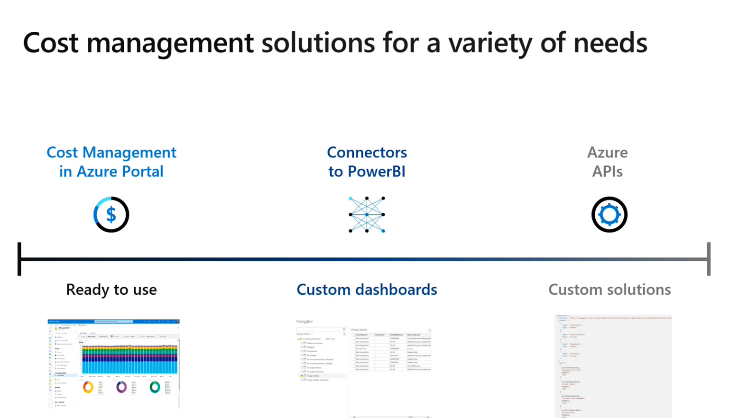
Notes:
Visibility

Slide 33
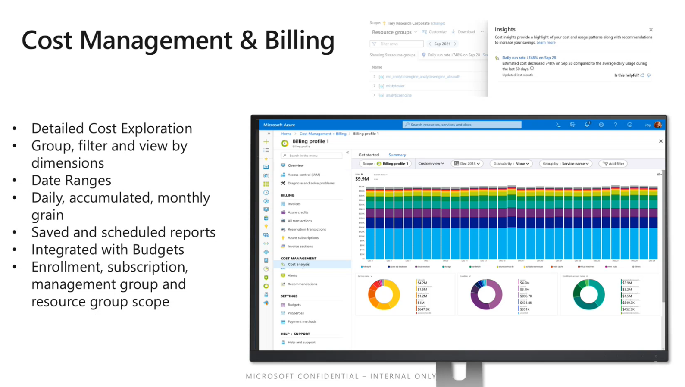

Slide 34
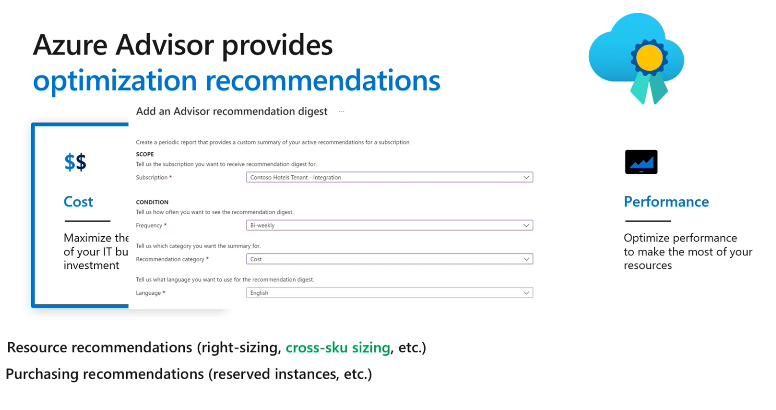

Slide 35
Accountability

Slide 36
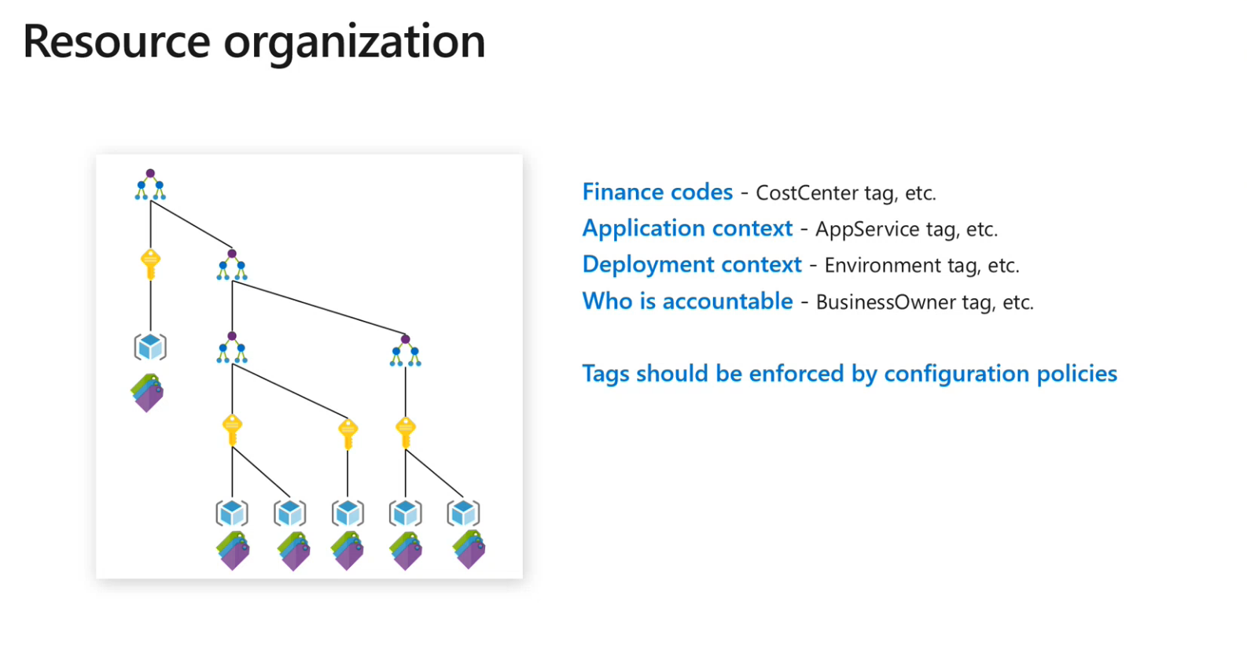

Slide 37
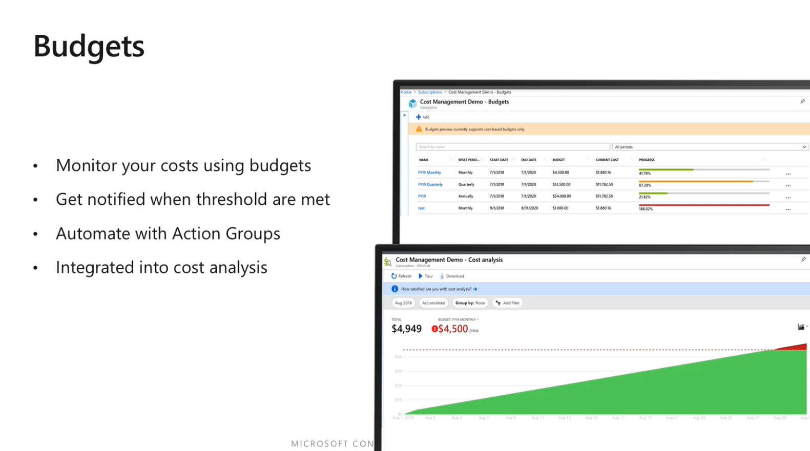

Slide 38
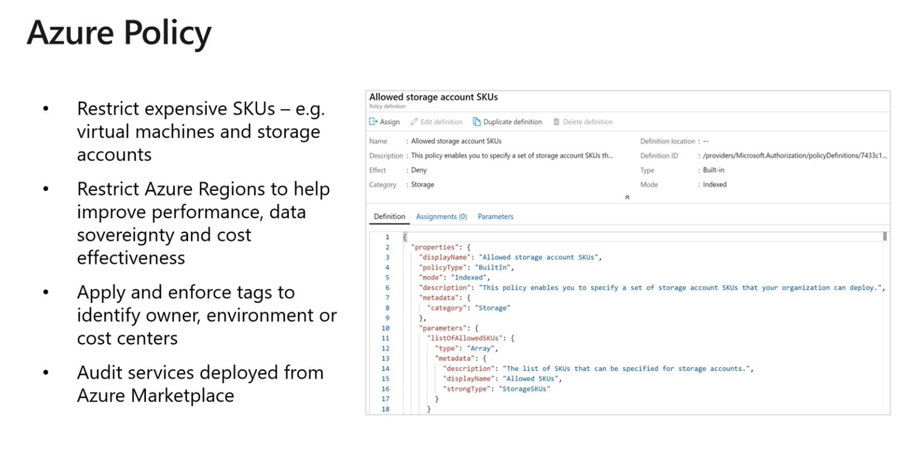

Slide 39
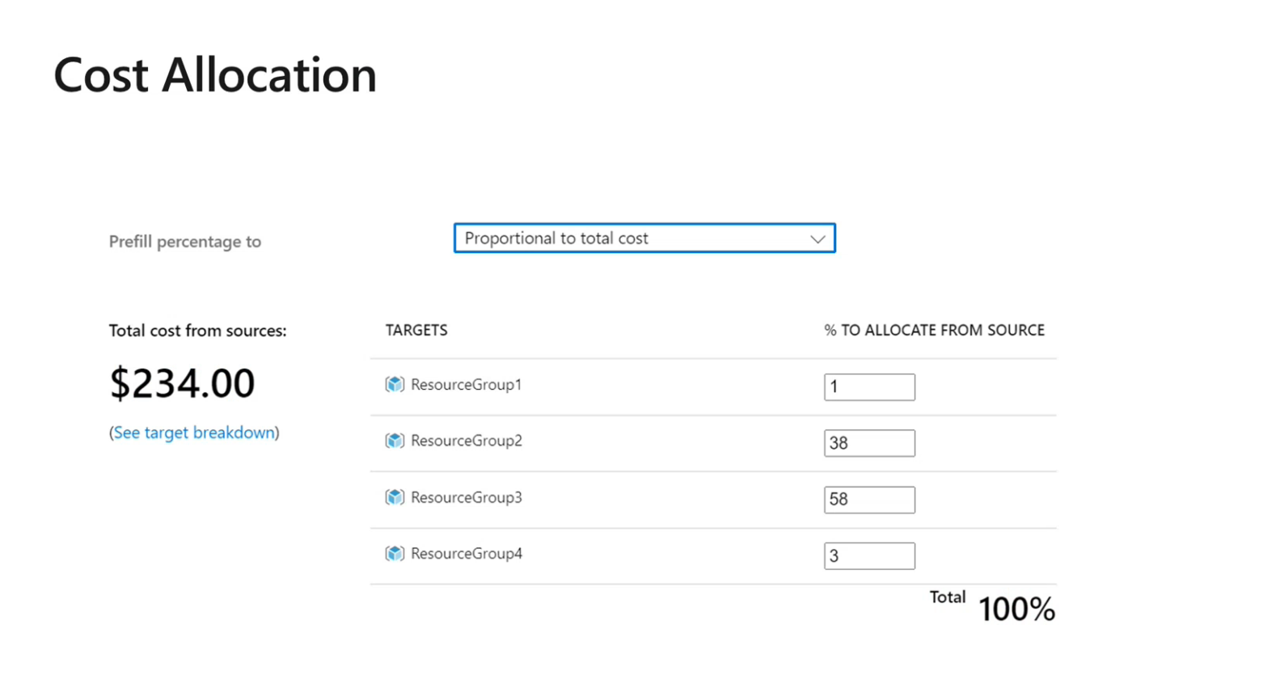
Notes:
Could still be in Preview

Slide 40
Optimisation

Slide 41
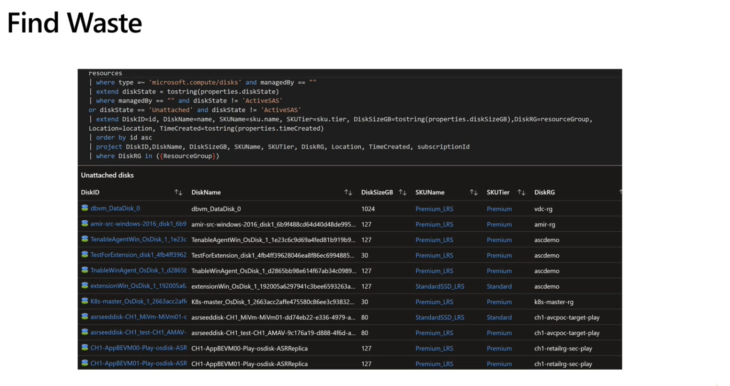
Notes:
Query that can find all unattached disks
Github repo has many queries

Slide 42
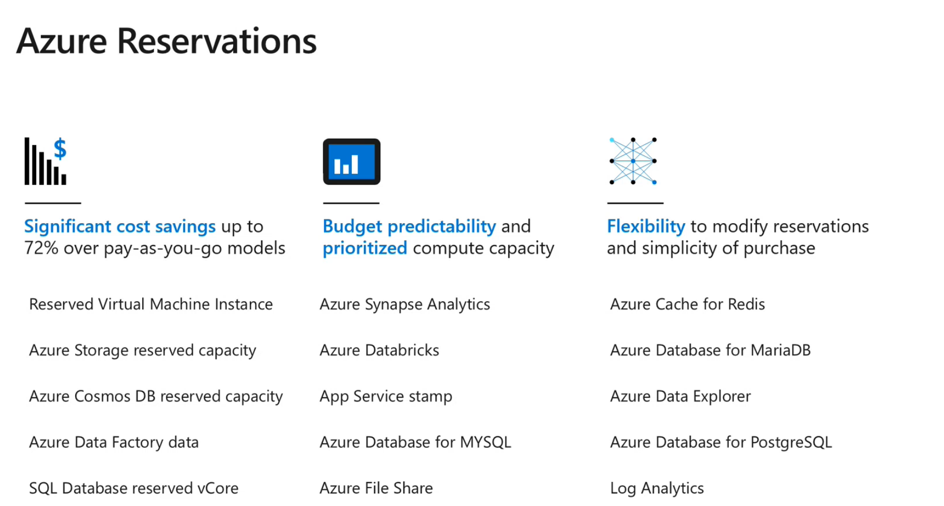

Slide 43
Automation Examples

Slide 44
Tag usages
Tag “stop: never”
Daily automation task, stops every resource without the tag

Slide 45
Scanning
Scan all created resources – find out who created them

Slide 46
Real Time Reporting
How can we provide information that teams need to make a better decision?

Slide 47
Reasoning
Feedback
Understanding business impact
Accountability
Informed decision
Notes:
The effect of communicate spending back to the engineers can be dramatic. Feedback

Slide 48
Report granularity
Per resource group
Tags can be used to mark resources per Department/Project

Slide 49
Per Service Optimizations

Slide 50
Azure Pricing Structure
Compute
vCores
Storage
Size
Tier
Misc
Licensing
Traffic
Service Tier
Notes:
Generally for IaaS
Storage Tiers
Hot
Cold
Archive
Azure SQL Managed Instance service tiers
General Purpose
Business Critical
Azure SQL Database service tiers
General Purpose
Hyperscale
Business Critical

Slide 51
Traffic and Storage optimizations
Traffic
Region traffic is free, cross region cost money
Mitigation: package resource close to each other, reduce cross region traffic
Storage
Storage is cheap, however large number of unused VHD becomes an issue.
Mitigation: identify orphaned VHDs, optimize storage utilization

Slide 52
Azure SQL Optimizations
Pricing tier
Reservations
Azure SQL Elastic Pool (combine multiple dbs into one)
Scale up / Scale down on schedule
Reduce size of the data (move historical data to archive)
Manual schema/code optimizations
Notes:
Optimize your Azure SQL Managed Instance cost with Microsoft Azure Well-Architected Framework
https://techcommunity.microsoft.com/t5/azure-sql/optimize-your-azure-sql-managed-instance-cost-with-microsoft/ba-p/2235216

Slide 53
Dev/Test workload optimizations
Visual Studio Subscriptions, Azure Dev/Test
Azure credits
Cheaper resources
Dev/Test licenses
Dev/Test Licenses for SQL Server
Azure Dev/Test
Combines with Azure Reservations for further discounts
Notes:
Why Azure Dev/Test pricing?
https://azure.microsoft.com/en-us/pricing/dev-test/#overview

Slide 54
Azure VM Optimizations
Azure Reservations (1 year, 3 years)
Size optimizations
Scale optimizations
Vertical scale – requires a reboot
Horizontal scale – add/remove VMs as needed
Shutdown VM (predictable load pattern)
Azure Spot Instances (for certain workloads)
Notes:
What are virtual machine scale sets?
https://docs.microsoft.com/en-us/azure/virtual-machine-scale-sets/overview
Use Azure Spot Virtual Machines
https://docs.microsoft.com/en-us/azure/virtual-machines/spot-vms

Slide 55
Storage optimization
Use Standard HDD for less demanding workloads
Premium HDDs for more demanding workloads
Tiered storage (hot, cold, archive)

Slide 56
Azure Functions – Pricing plans
Consumption
Pay per use
Autoscale
Premium
Pay per use
Higher usage
Dedicated
Dedicated Compute
User Scale
Low usage
Prewarm instances
Autoscale
Notes:
Azure Functions hosting options
https://docs.microsoft.com/en-us/azure/azure-functions/functions-scale#scale

Slide 57
Azure Monitor
Pricing
Ingested data
Stored data
Optimizations
Minimise ingested data (only data you need)
Reduce retention period
Archive old data

Slide 58
App Service
Autoscale
Multiple websites in a single App Service Plan
Cost Analysis
Budget Alerts (per scope)
Cost Alerts

Slide 59
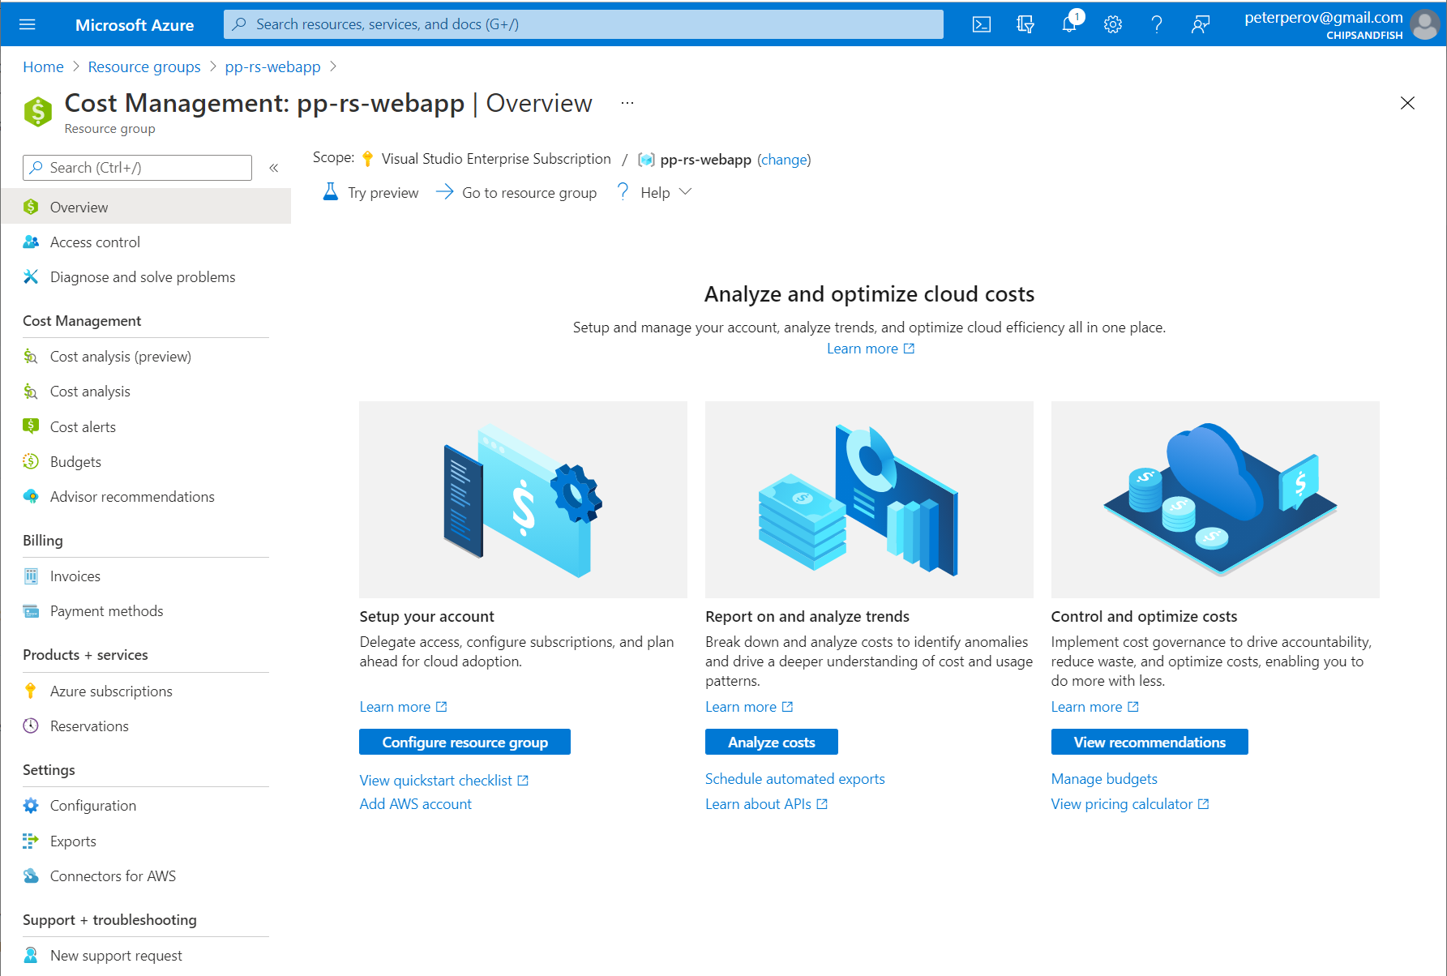
App Service Cost Analysis

Slide 60
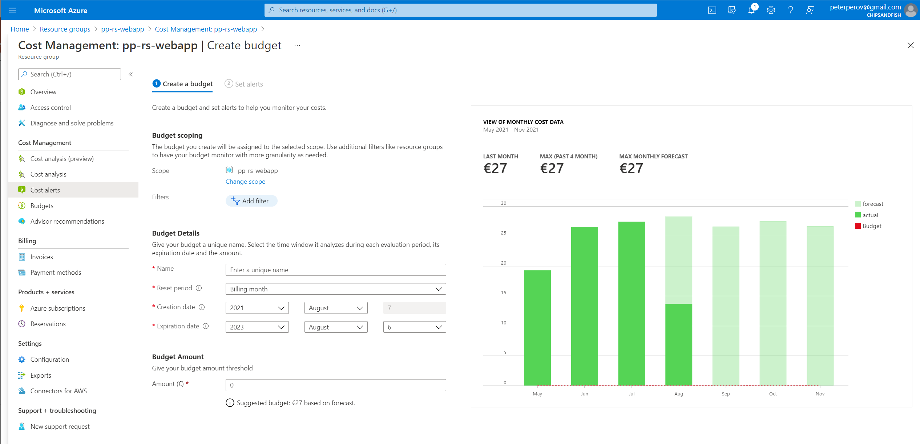
Cost Alerts

Slide 61
Traffic
Ingress traffic is free, egress traffic is not
Traffic “inside” region is free, between regions is not
Consolidate “heavy traffic” resources inside the region
Minimise cross-region traffic

Slide 62
Conclusion

Slide 63
Further Reading
O’Reilly, Cloud FinOps: Collaborative, Real-Time Cloud Financial Management
FinOps Foundation, https://www.finops.org/
Notes:
O’Reilly, Cloud FinOps: Collaborative, Real-Time Cloud Financial Management
https://www.amazon.com/Cloud-FinOps-Collaborative-real-time-management/dp/1492054623

Slide 64
Azure Policies Examples
Limit vCores available for Developers
Limit resources available for creation
Enforce tag creation with an error message
Cost center tag
Shutdown: daily/weekly/never tag
Certain tags can only be added by a trusted group
Notes:
There are 500+ Azure Services available for creation, it’s easier to disable everything and only allow necessary resources.

Slide 65
Resource Scanner
Scan all resources without tag
Utilization and logging

Slide 66
Demo Azure Monitor?
Log information
Create Alert

Slide 67
Demo Azure Blueprints and Policies

Slide 68
Demo Azure Budget
Notes:
Use cost alerts to monitor usage and spending
https://docs.microsoft.com/en-us/azure/cost-management-billing/costs/cost-mgt-alerts-monitor-usage-spending

